Slide 1


T1A2
Coder Academy
Portfolio Assignment
John Faber Rodriguez Corredor
Term 1
2023
Notes:
YOUTUBE LINK PRESENTATION !!!
https://www.youtube.com/watch?v=ehRp_iuQ7Mw

Slide 2
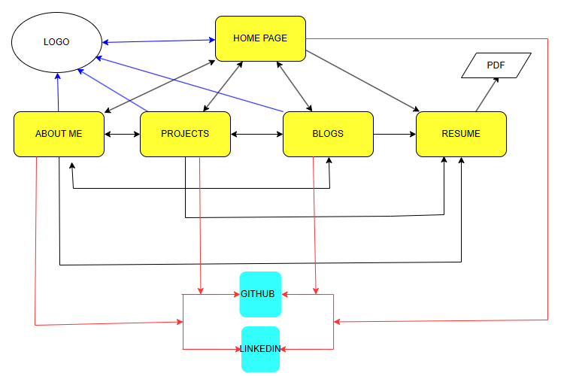
Sitemap
Logo linked to “home” page
My resume shared directly from my one drive
Social logos contain hyperlink to my social profiles in both platforms

Slide 3
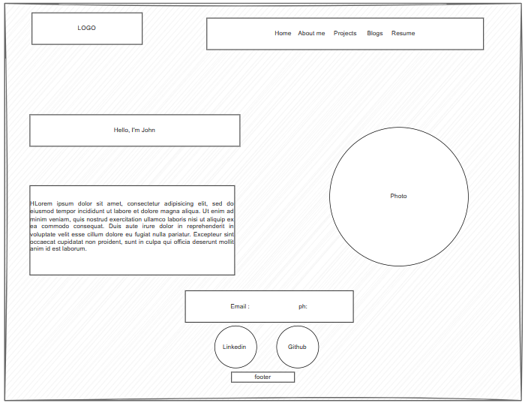
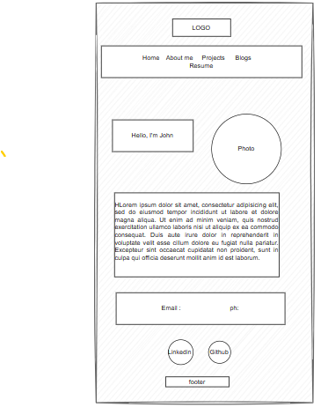
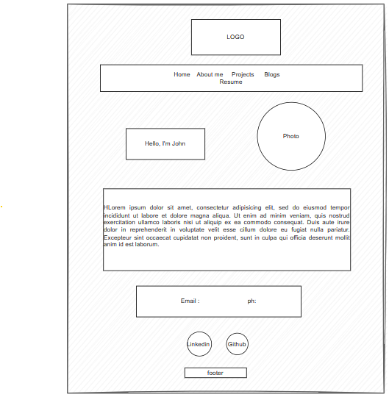
Home page
( WIREFRAMES Mobile, Tablet and Desktop view)
Logo work as home too.
Linkedin and Github Profiles
My email and phone number
Intro of my services
Footer ( Copytight Notice)

Slide 4

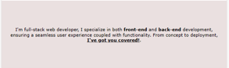
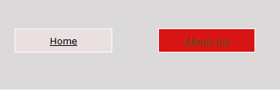


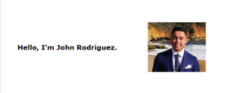
HOME PAGE
COMPONENTS
Linked to home page
Turns red once hover
Linked to my linkedin and Github profiles.
Copyright purposes

Slide 5
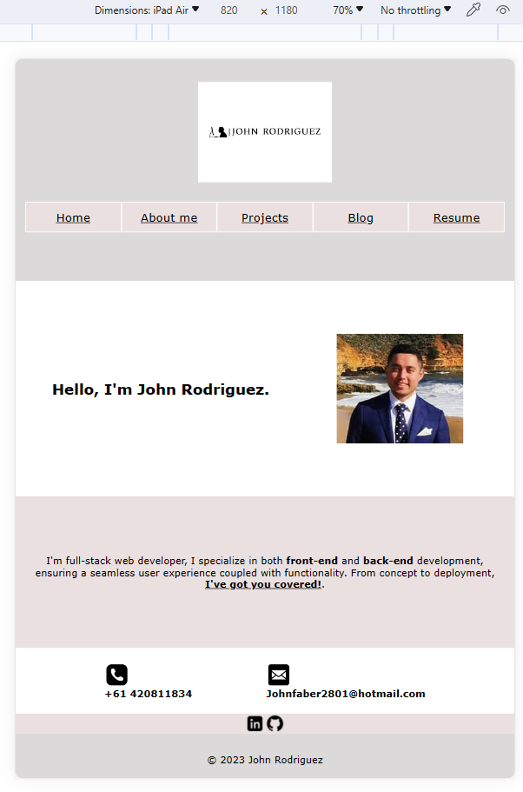
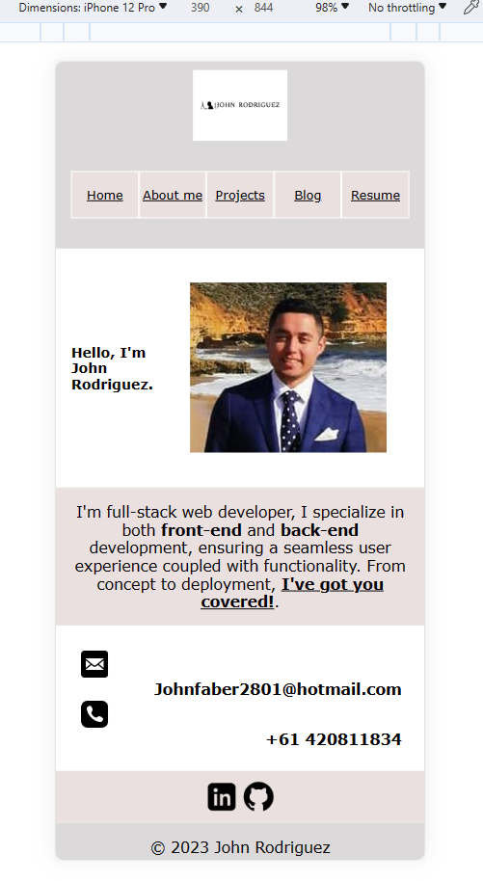
Home page Mobile & Tablet view

Slide 6
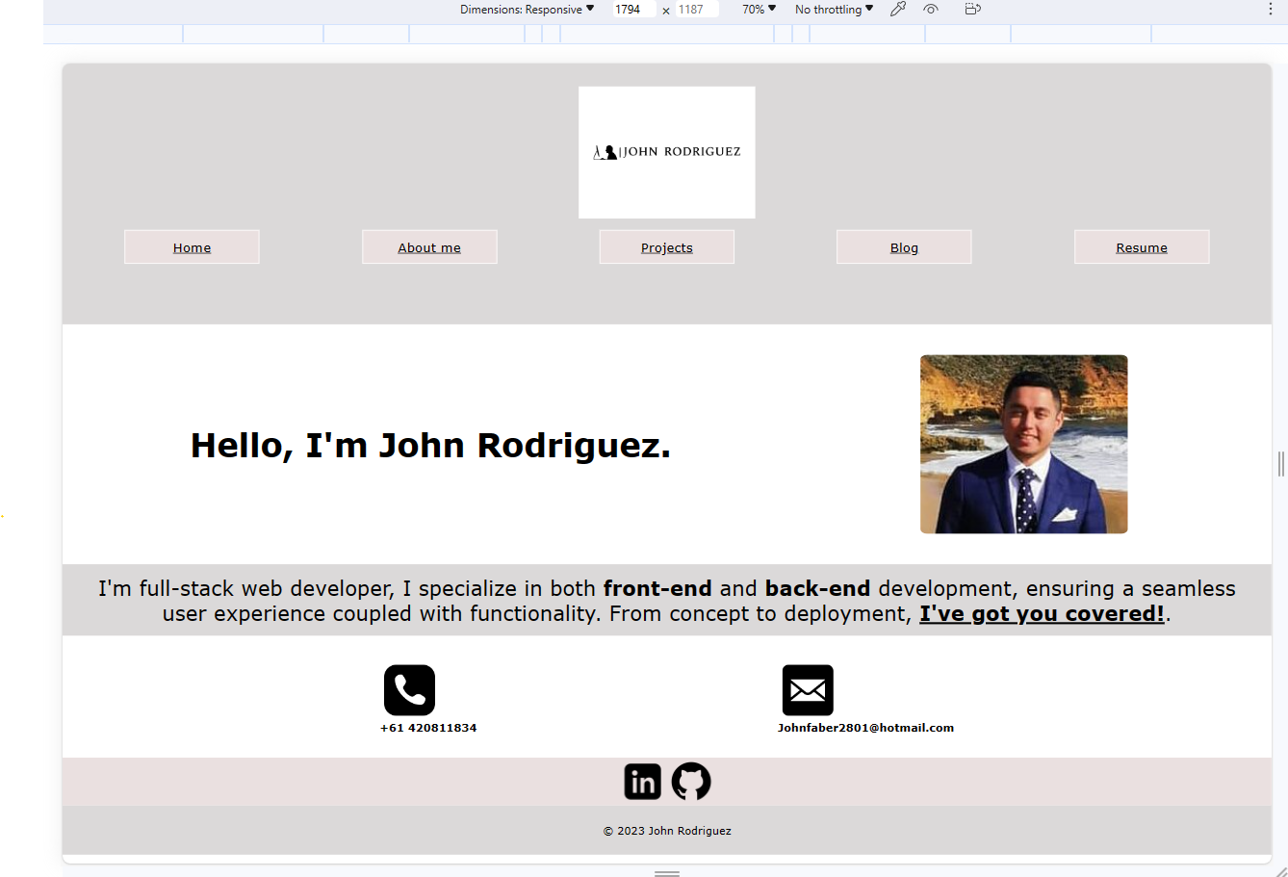
Home page Desktop view

Slide 7
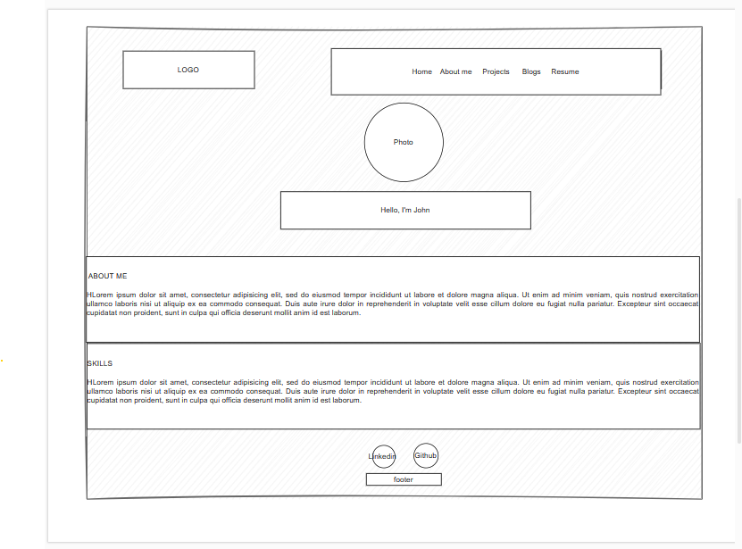
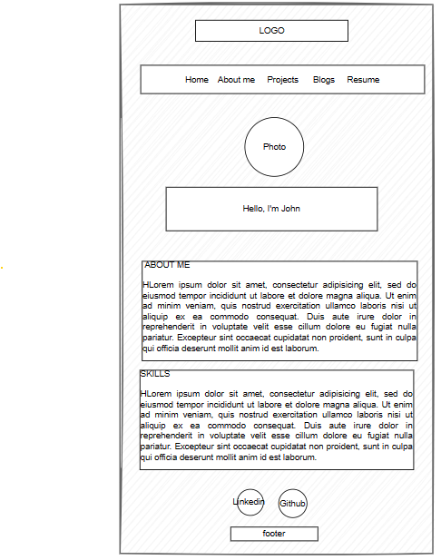
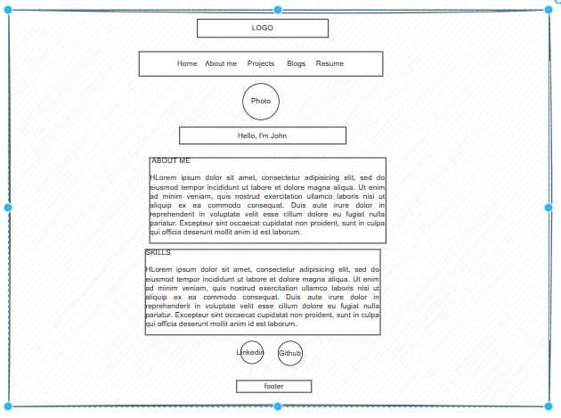
About me
Wireframes Mobile, Tablet and Desktop view.
About me
My photo
My hard Skills

Slide 8
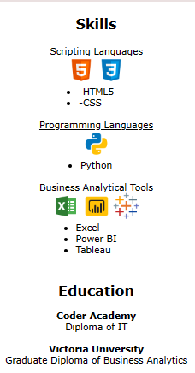
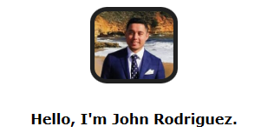
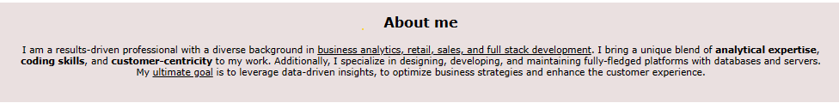
About me
COMPONENTS
Showcase of my hard skills and education

Slide 9
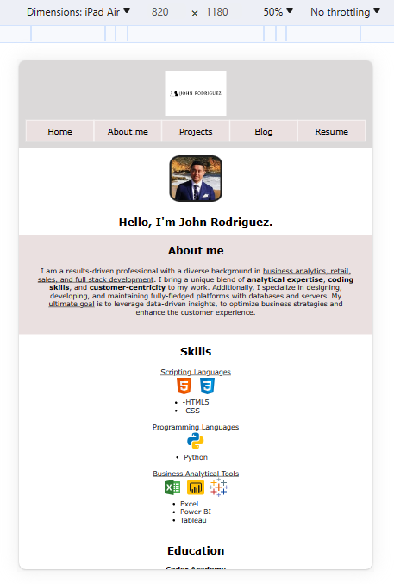
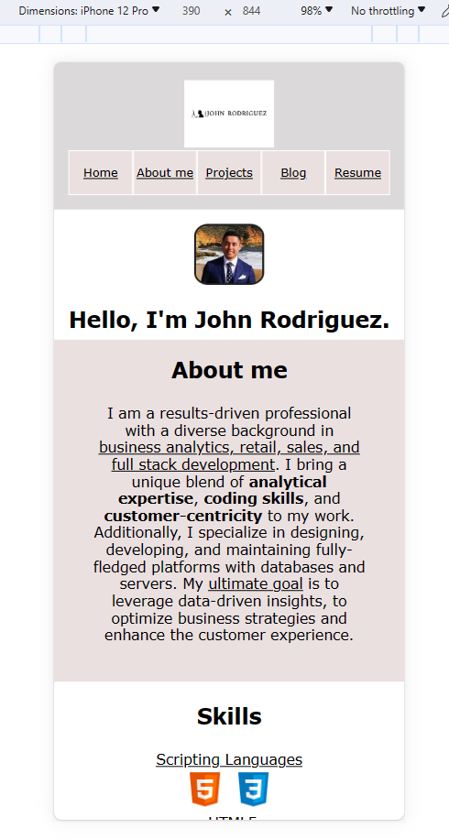
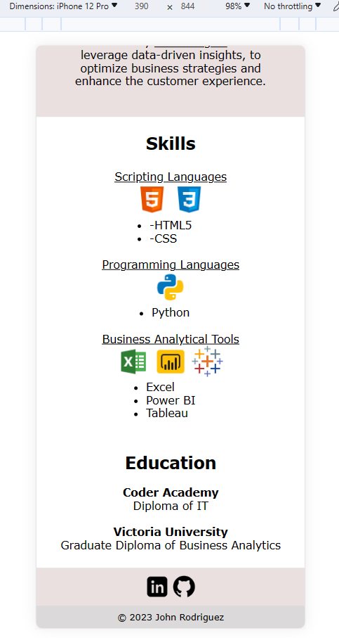
About me page Mobile & Tablet view

Slide 10
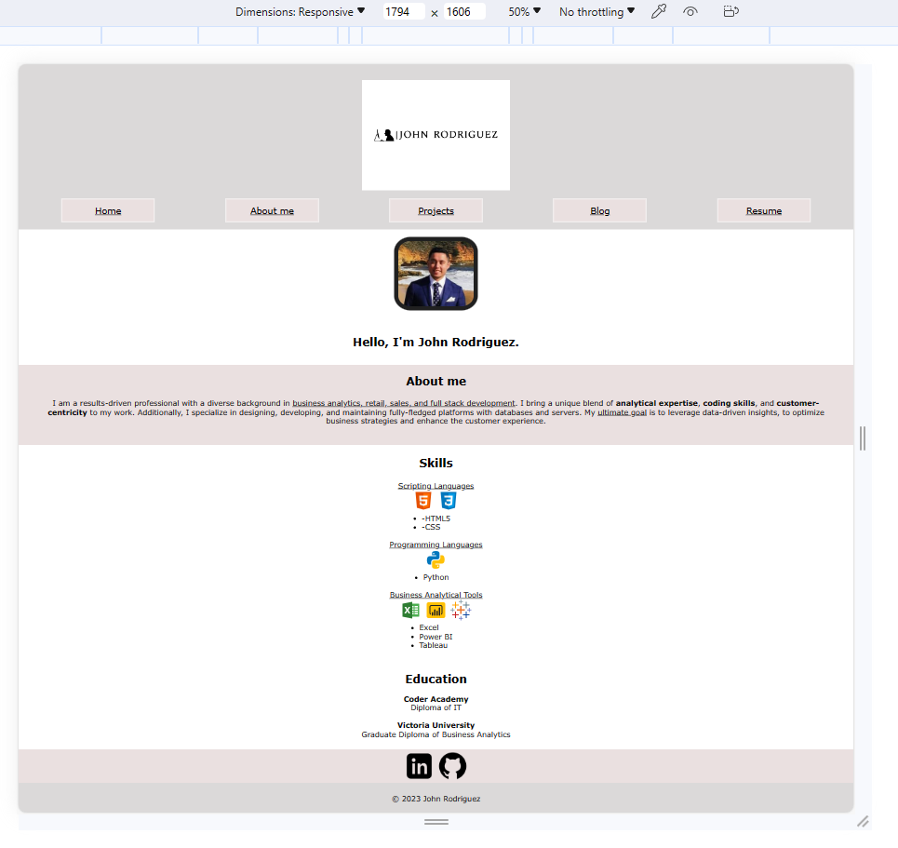
About me page Desktop view

Slide 11
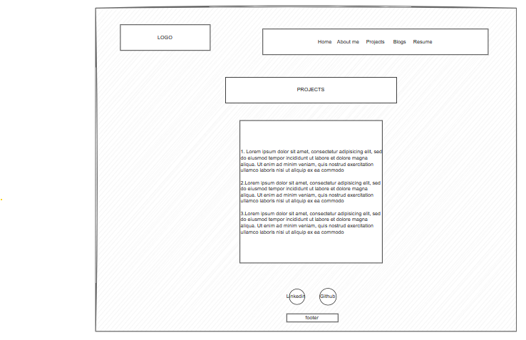
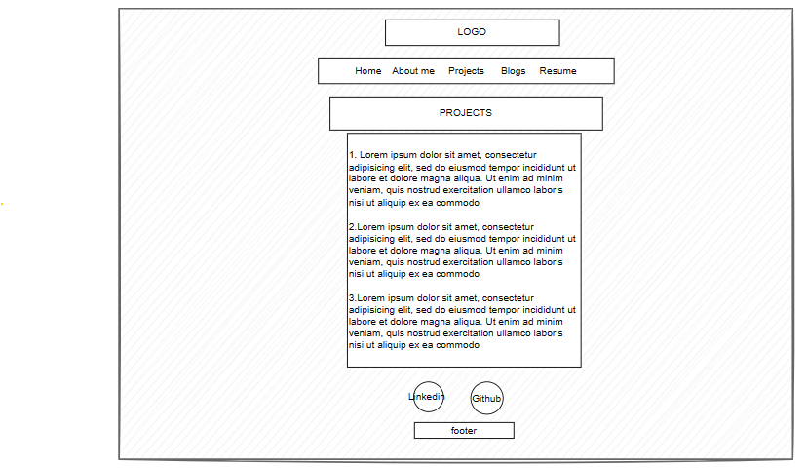
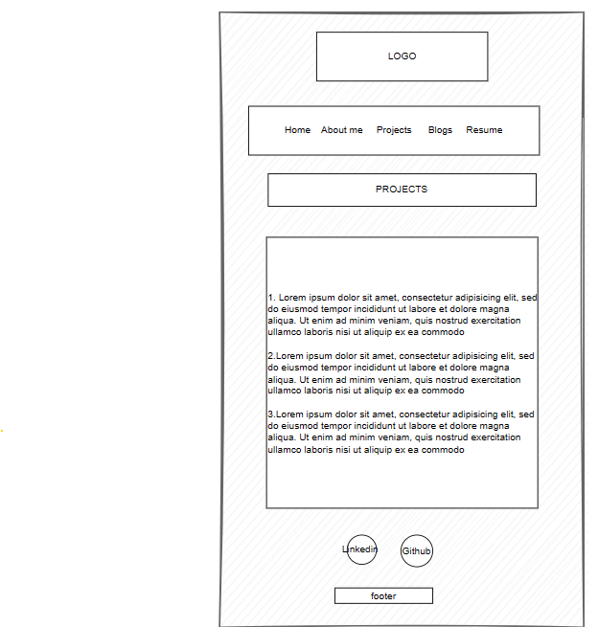
Project Page
Wireframes Mobile, Tablet and Desktop view.
Projects Description
My hard Skills

Slide 12
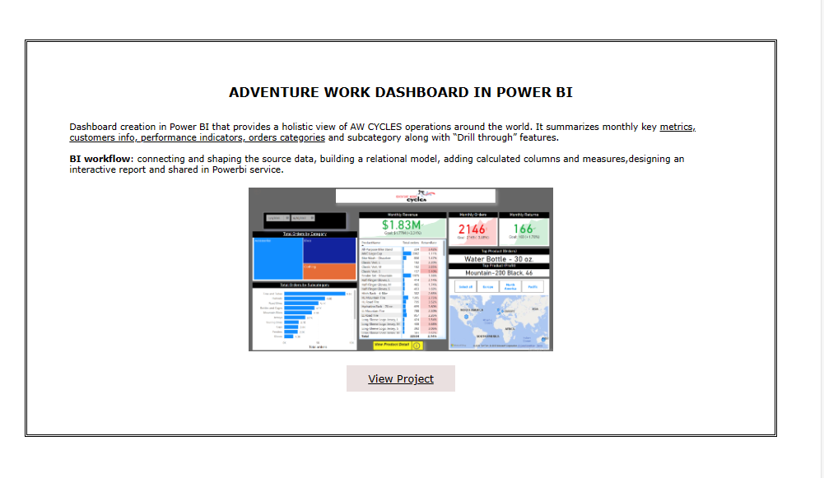
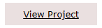
Projects
COMPONENTS
Linked to home page
Margin, and Padding were adjusted to center the project
Linked to live dashboard in PowerBi

Slide 13
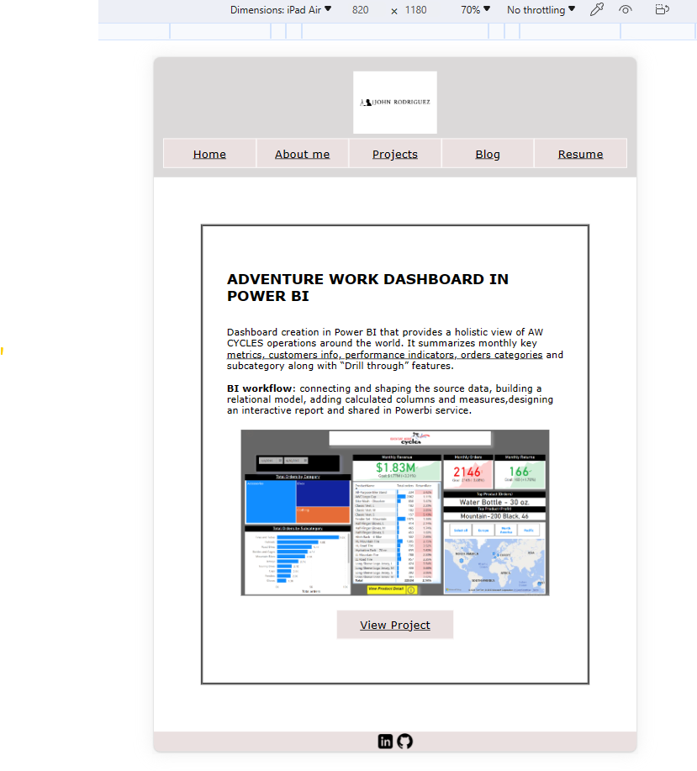
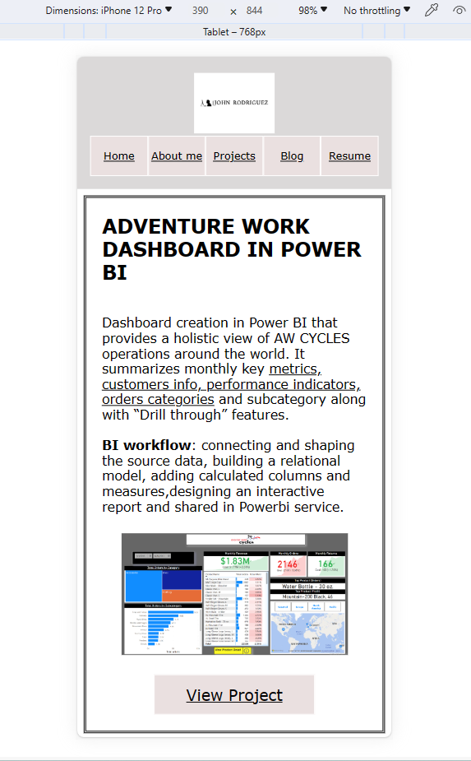
Project Page
Mobile & Tablet view

Slide 14
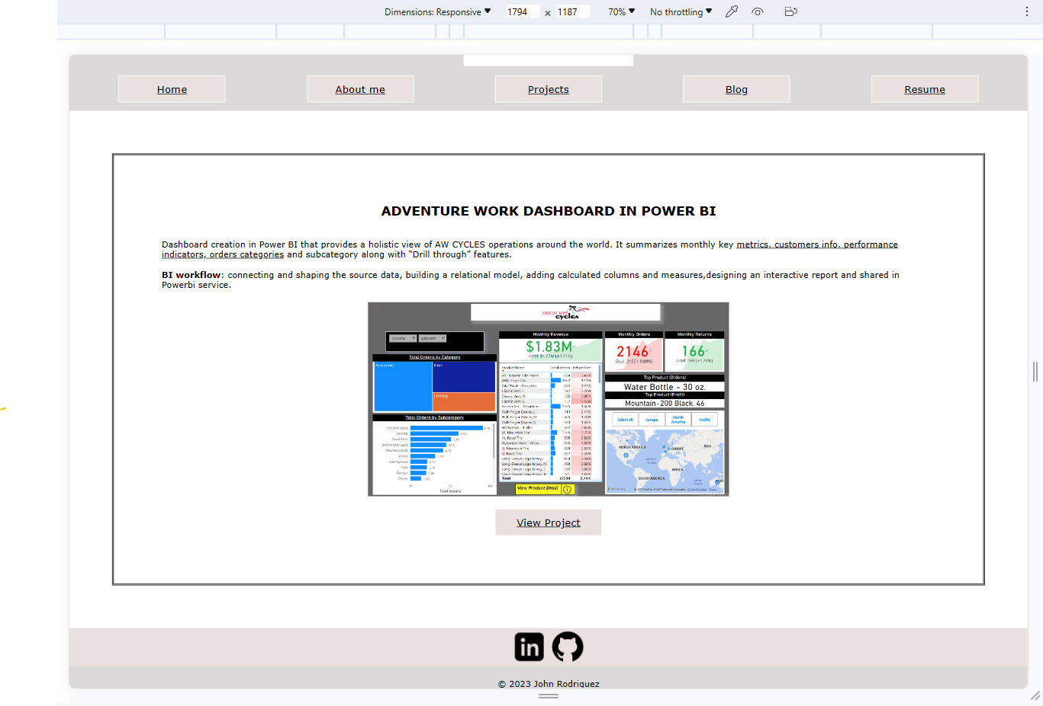
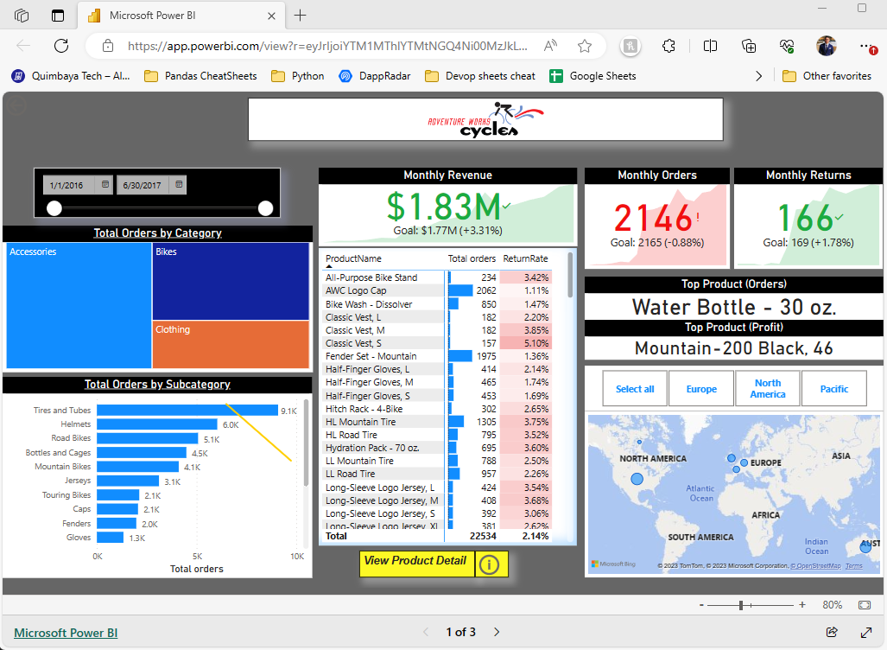
Project Page
Desktop view

Slide 15
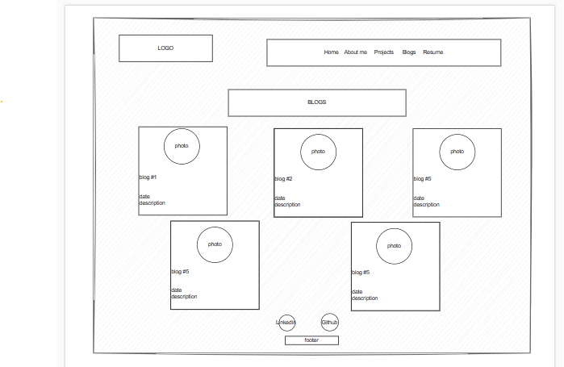
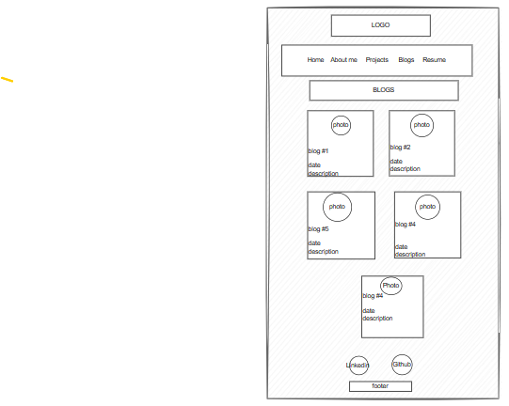
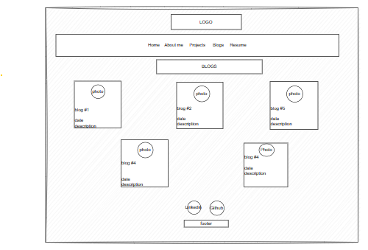
Blog page
Wireframes Mobile, Tablet and Desktop view.
Blog #
Date published
content
Blog photo
My hard Skills

Slide 16
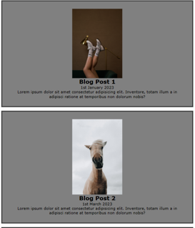
BLOG
COMPONENTS
MAIN component with 5 sections with a column's direction
Pictures in every section related to the blog content
Pictures in every section related to the blog content

Slide 17
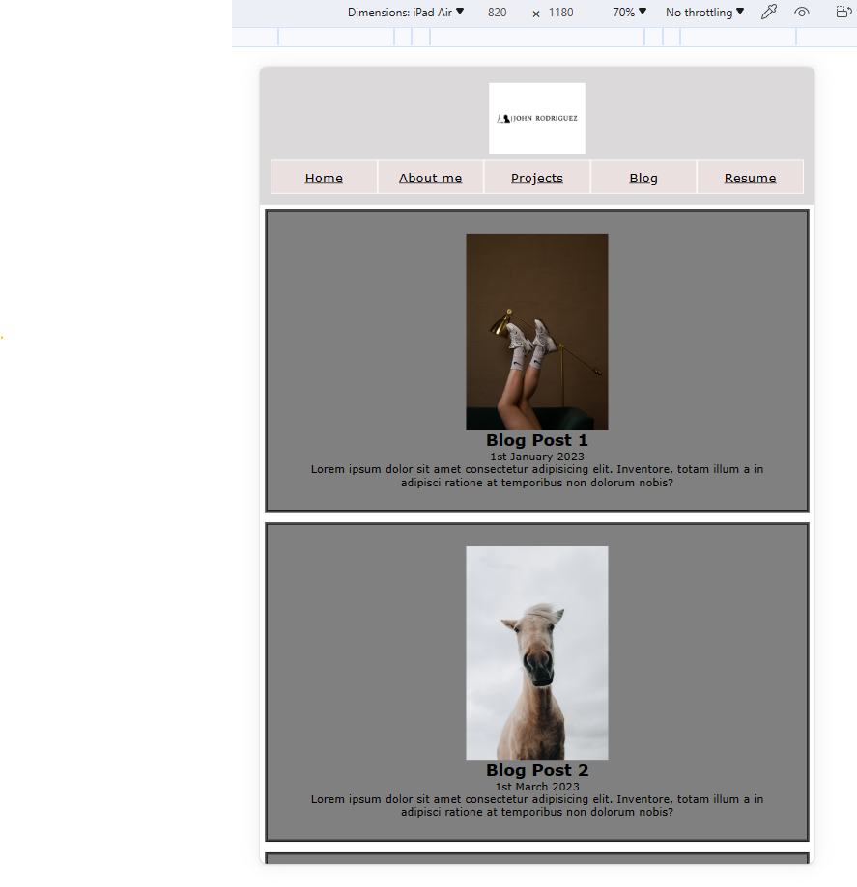
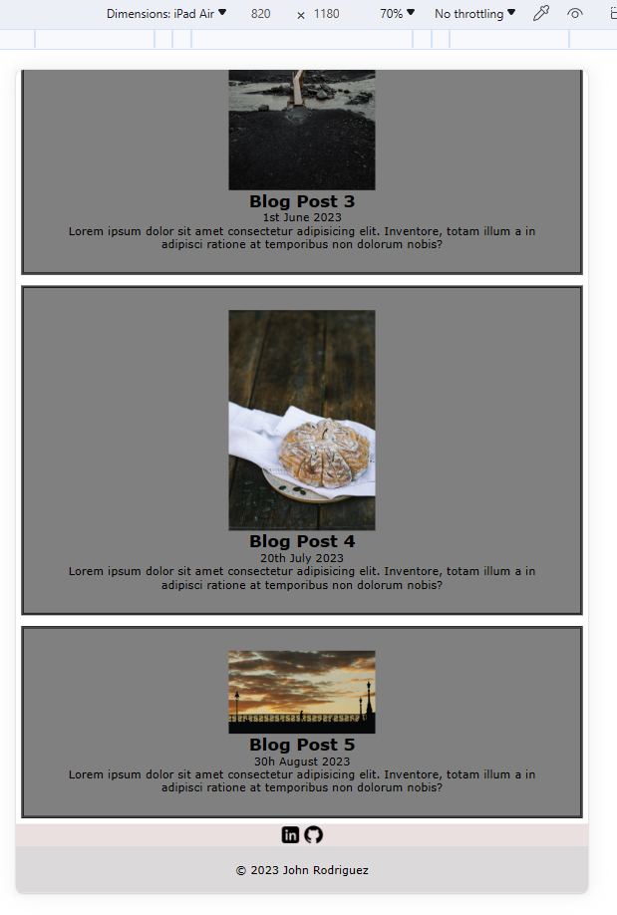
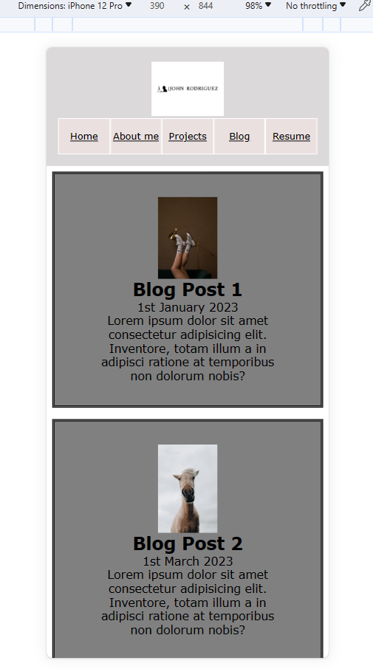
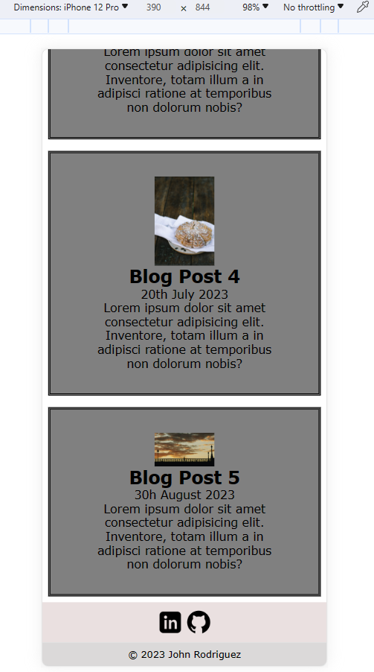
Blog page
Mobile & Tablet view.

Slide 18
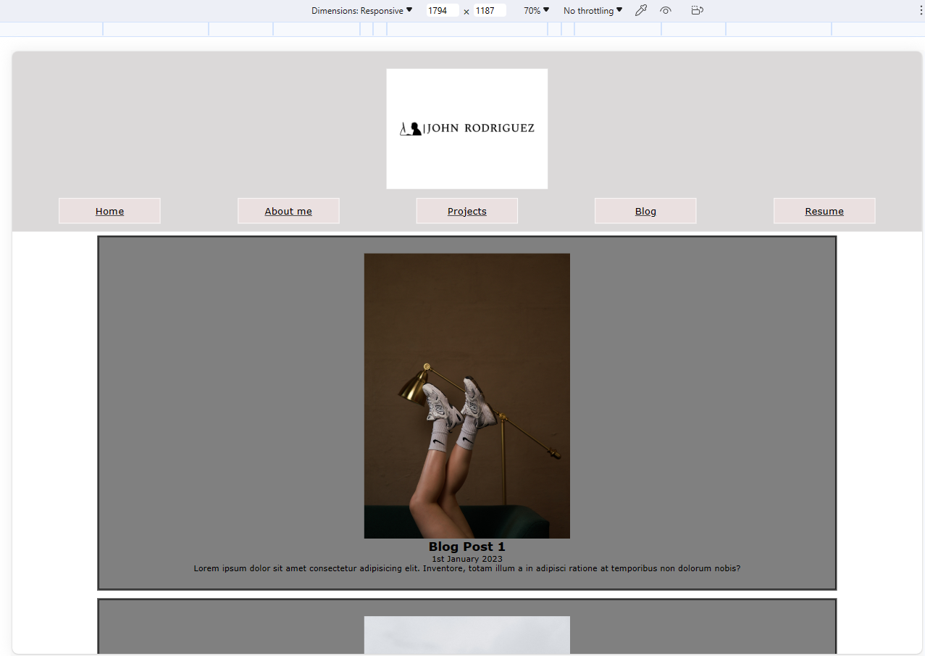
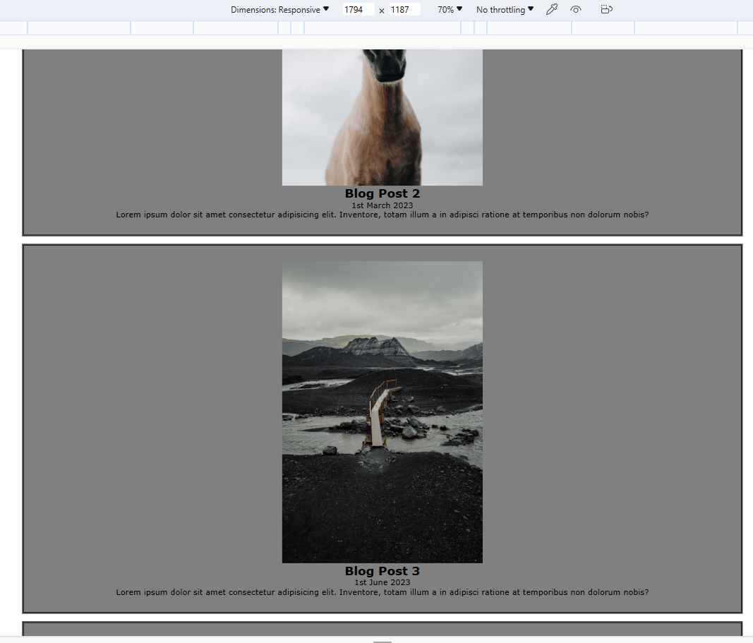
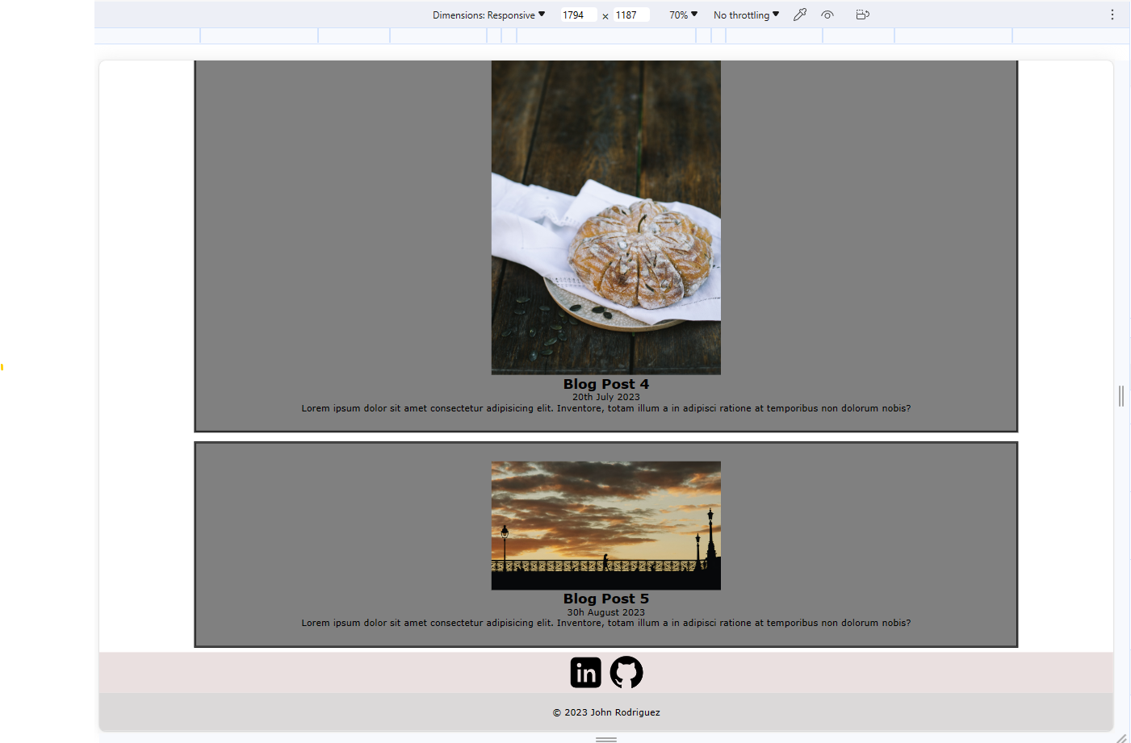
Blog page
Desktop view.

Slide 19
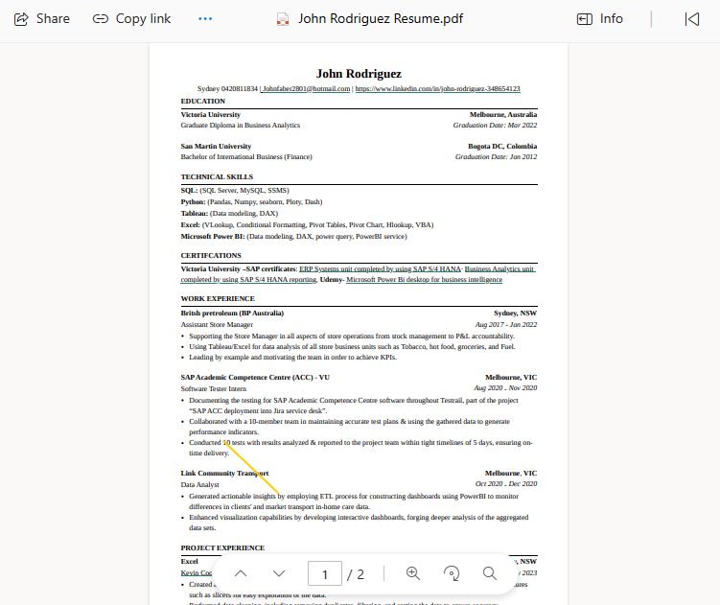
Resume button
Resume shared from my one drive

Slide 20
T1A2
Coder Academy Portfolio Assignment
John Faber Rodriguez Corredor
Term 1
2023
THANKS FOR WATCHING!

